Slide 1
Optical Illusions

Slide 2

What do you see?
White vase.
Two black faces.

Slide 3

What do you see?
Duck.
Rabbit.

Slide 4

What do you see?
Woman’s face.
A man playing the saxophone.

Slide 5
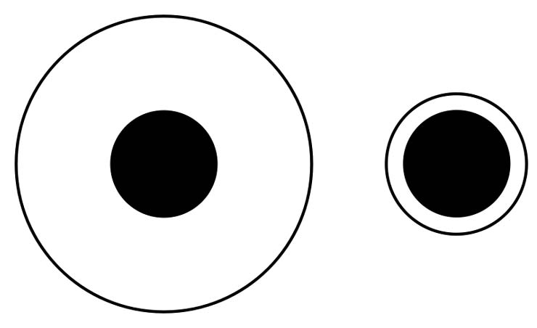
Are the black dots the same size?
Yes!

Slide 6
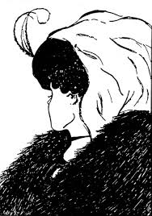
What do you see?
Old woman.
Young woman.

Slide 7
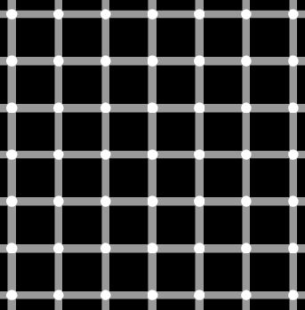
What do you see?
When looking at the grid, dark dots seem to appear and disappear at random.

Slide 8

What do you see?
Black arrows.
White arrows.

